Slide 1

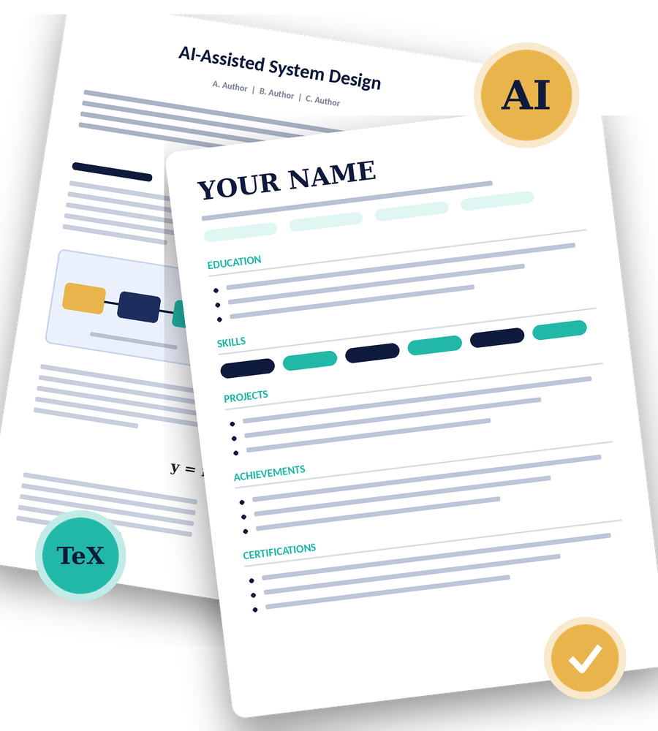
DAY 2 | SESSION 1
AI Tools Essential for Engineering Students
Three-Day Student Workshop
AI-Assisted Research, Technical Writing & Resume Development
M Mahenoor | Rida Arshad | Shaguftha Nikhar
Notes:
Welcome everyone. Introduce yourselves (Mahenoor, Rida, Shaguftha). Today is a hands-on session. By the end you will have a research paper started in Overleaf and a one-page resume.

Slide 2
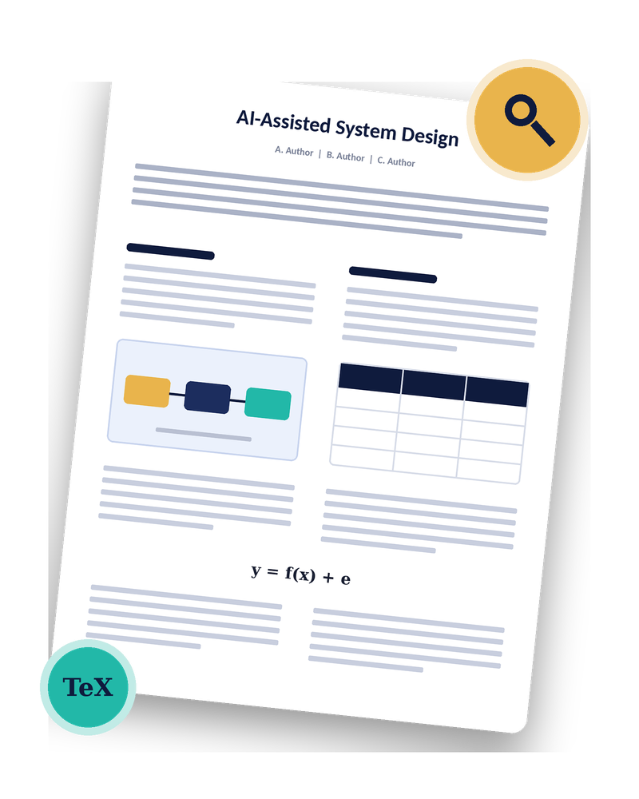
PART A
AI-Assisted Research & Paper Development
Research tools
Paper structure
Overleaf & LaTeX
IEEE template
AI for LaTeX
Paper demo
Notes:
Part A: research tools, paper structure, Overleaf and LaTeX, then hands-on time.

Slide 3










RESEARCH TOOLS
Pick the Right AI Tool for the Task
Find information
Find research papers
Understand papers
Find related papers
Perplexity
Google Scholar / Elicit / ScholarGPT
NotebookLM / SciSpace
ResearchRabbit
Check evidence
Synthesize sources
Research assistance
Diagrams and images
Consensus
ChatGPT / NotebookLM
Anara / Bohrium AI
Napkin AI / Gemini / Mermaid / MS Designer
Golden rule: cross-check everything AI tells you
AI Tools Essential for Engineering Students | Day 2 - Session 1
4
Notes:
Walk through one tool per task. No single tool does everything: use search tools to find, reader tools to understand, and synthesis tools to compare. For figures and flowcharts: Napkin AI turns text into diagrams, Gemini image generation makes illustrations, Mermaid builds flowcharts from simple text code, and Microsoft Designer makes polished graphics.

Slide 4




LITERATURE SEARCH
From Query to Research Gap
1
2
3
4
5
Search
Understand
Compare
Find the gap
Cross-check
Write effective queries and pick reliable sources
Read the abstract, methodology and findings
Look across multiple sources side by side
What is missing, weak or unsolved?
Verify AI answers and citations
BUILD A SMART QUERY
TOPIC
METHOD
APPLICATION
smart traffic
reinforcement learning
signal control
SEARCH smart traffic reinforcement learning signal control
AI Tools Essential for Engineering Students | Day 2 - Session 1
5
Notes:
Live tip: type a vague query, then a specific one, and compare the results. Then show how to identify a research gap: what do all the papers ignore or fail to solve?

Slide 5
CROSS-CHECKING
AI Sounds Confident. Check It Anyway.
AI tools can invent papers, authors and numbers that look completely real.
1
2
3
Does it exist?
Does it say that?
Are the details right?
Search the paper title in Google Scholar. Fake citations often look perfect.
Open the paper. Read the abstract and results yourself.
Check authors, year, venue and DOI before you cite anything.
AI Tools Essential for Engineering Students | Day 2 - Session 1
6
Notes:
This is the most important habit of the day. Ask: who has seen an AI give a wrong answer confidently? Every citation gets checked at the source.

Slide 6
PAPER STRUCTURE
Anatomy of a Research Paper
1
Title
2
Abstract
3
Introduction
4
Literature Review
What the paper is about
Problem, method and result in brief
Problem statement and motivation
What exists and where it falls short
5
Methodology
6
Results
7
Conclusion
8
References
How you solved the problem
What you found and what it means
Key takeaways
Every source you cited
ALSO INCLUDE
Keywords
Problem Statement
Research Gap
Technology Stack
System Architecture
Discussion
Limitations & Future Scope
AI Tools Essential for Engineering Students | Day 2 - Session 1
7
Notes:
Read the flow left to right, top to bottom. Stress that the research gap comes out of the literature review and drives the methodology.

Slide 7



OVERLEAF & LATEX
Meet Overleaf and LaTeX
Overleaf
Recompile
A LaTeX editor in your browser. Nothing to install, easy to share.
main.tex
refs.bib
LaTeX
figures/
A typesetting system for technical papers. Equations, figures and references stay consistent.
IEEE.cls
Why it matters
IEEE provides ready-made LaTeX templates for papers.
AI Tools Essential for Engineering Students | Day 2 - Session 1
8
Notes:
Show the three panes: file tree, source editor and PDF preview. Explain that you type in the middle and the paper appears on the right after you compile.

Slide 8
OVERLEAF & LATEX
Anatomy of a .tex File
\documentclass
Sets the template type
main.tex
\documentclass[conference]{IEEEtran}
\usepackage{graphicx}
\begin{document}
\title{My Paper Title}
\maketitle
\section{Introduction}
Your text goes here...
\bibliographystyle{IEEEtran}
\bibliography{references}
\end{document}
\usepackage
Adds extra features
\section
Builds the paper structure
\bibliography
Links your .bib references
Recompile
Builds the PDF preview
AI Tools Essential for Engineering Students | Day 2 - Session 1
9
Notes:
Walk through the skeleton line by line. Everything before \begin{document} is setup (class and packages). Everything after is content. Show how to add a package and how the bibliography file connects.

Slide 9








IEEE TEMPLATE
IEEE Formatting Essentials
Find the template
Two-column layout
Title and authors
Pick the right IEEE one
Understand the IEEE format
Add affiliations too
Abstract and keywords
Figures and captions
Tables
Format them correctly
Add and label visuals
Create and format them
Equations
Citations
Cross-references
Write maths in LaTeX
Reference formatting
Figures, tables, sections
AI Tools Essential for Engineering Students | Day 2 - Session 1
10
Notes:
Show where to find the IEEE conference template in Overleaf's template gallery. Then click through each of these nine elements in the template.

Slide 10





AI + LATEX
Let AI Write the LaTeX for You
Tables from structured content
SAMPLE PROMPT
Mathematical equations
Create an IEEE-style LaTeX table with the columns Method, Accuracy and Limitations. Add a caption and a label so I can cross-reference it.
Flowcharts and diagrams
Formatting changes
Fixes for compile errors
Verify before you use it: compile the code and check every fact.
Code adapted from GPT tools
AI Tools Essential for Engineering Students | Day 2 - Session 1
11
Notes:
Demo: ask an AI tool for a table, paste it into Overleaf, compile. Then deliberately paste a broken snippet and show how to give the error log back to the AI to debug it.

Slide 11


DEMONSTRATION
Inside a Real Research Paper
IEEE structure and organization
Results and discussion
Methodology and system architecture
References and citations
LIVE DEMO
Flowcharts and technical diagrams
LaTeX implementation in Overleaf
The trainer's major project research paper in Overleaf
Figures, tables and equations
Practical use of AI while writing
AI Tools Essential for Engineering Students | Day 2 - Session 1
12
Notes:
Open your own paper in Overleaf. Follow the checklist on the right and show at least one place where AI helped and one where you corrected it.

Slide 12
PART A | HANDS-ON
Research Hands-On
1
Select a topic
2
Literature search
3
Gap and outline
Choose a topic from your engineering discipline.
Find 3-5 papers. Note findings, methods and limitations.
Problem, existing approaches, limits, gap. Draft your structure.
4
Create the paper
5
Tech elements
6
Compile & debug
Open an IEEE template. Add title, authors, abstract, sections and references.
Add a figure, flowchart, table and equation using AI-assisted LaTeX.
Compile and fix at least one LaTeX issue with AI help.
AI Tools Essential for Engineering Students | Day 2 - Session 1
13
Notes:
Walk around the room. Remind students: AI helps, but they own the choices. Halfway through, check that everyone has found at least 3 papers.

Slide 13

PART A | CHECKPOINT
What You Should Have by Now
3-5 papers with findings, methods and limitations noted
A clear research gap and a paper outline
Stuck?
An IEEE template in Overleaf with title, authors, abstract and references
Describe the problem to AI and paste the compile log. Then check the fix yourself.
At least one figure, flowchart, table and equation
A compiled paper with one LaTeX issue fixed using AI
AI Tools Essential for Engineering Students | Day 2 - Session 1
14
Notes:
Use this as a self-check. Anyone missing an item should raise a hand and get help.

Slide 14

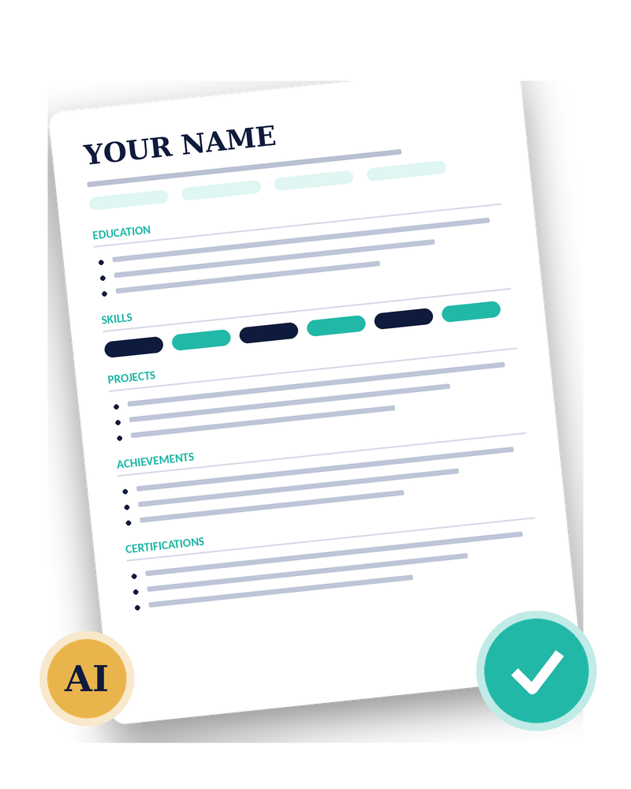
PART B
AI-Assisted Resume Building with Overleaf
Resume vs CV
Key components
AI for content
Overleaf resume
GPT for LaTeX
Resume demo
Notes:
Part B: same rhythm as Part A. Explanation first, then you build your resume.

Slide 15



RESUME VS CV
Resume or CV? Know the Difference
Resume
CV
Short and focused: one page for students
Tailored to a specific role
Used for industry and placement applications
Highlights skills, projects and achievements
Longer and more detailed
Full academic record
Used for academic and research applications
Includes research, publications and teaching
Today's goal: a one-page, industry-ready engineering resume
AI Tools Essential for Engineering Students | Day 2 - Session 1
16
Notes:
Ask: which one would you send to a product company? Which to a university lab? Explain that we build a resume today, but the CV demo shows the difference.

Slide 16









KEY COMPONENTS
What Goes on an Engineering Resume
Name and contact
Professional links
Education
Technical skills
Projects
Internships and experience
Research
Certifications
Achievements
Positions of responsibility
Include what is relevant to the target role. Not every section is needed.
AI Tools Essential for Engineering Students | Day 2 - Session 1
17
Notes:
Quickly go through the ten sections. Ask students which ones they already have material for and which are empty.

Slide 17





AI-ASSISTED CONTENT
How AI Can Sharpen Your Resume
Structure your info
Grammar and content polish
Turn scattered details into clean sections
Fix wording and consistency
Concise project write-ups
Find what is missing
What you built, how, and the result
Spot gaps in your details
Stronger bullet points
Tailor to a target role
Sharper achievement and experience lines
Match your content to the job
Organize technical skills
Generate LaTeX
Group them into clear categories
Create or modify template code
AI Tools Essential for Engineering Students | Day 2 - Session 1
18
Notes:
Emphasise that AI helps with wording and structure, but the facts have to come from the student.

Slide 18


BULLET MAKEOVER
From Vague to Valuable
BEFORE
AFTER
Made a website for my college project. Worked on the backend.
Built a [type of app] using [tech stack] that [what it does], [measurable result].
Action verb
+
What you built
+
Tech used
+
Impact
Illustrative structure only. Use facts that are true for you.
AI Tools Essential for Engineering Students | Day 2 - Session 1
19
Notes:
Live activity: ask a volunteer for one weak bullet from their own project and improve it together using the formula. Warn that the numbers must be real.

Slide 19
OVERLEAF RESUME
Build Your Resume in Overleaf
1
Find a suitable resume template
2
Create an Overleaf resume project
3
Understand the template structure
4
Add sections and hyperlinks
5
Adjust spacing and alignment
6
Manage fonts and section headings
7
Keep a clean one-page layout
8
Compile and export the final PDF
AI Tools Essential for Engineering Students | Day 2 - Session 1
20
Notes:
Show where resume templates are in Overleaf. Emphasise a clean one-page layout. Show how to change a section heading and how to add a hyperlink.

Slide 20
GPT + LATEX
Ask GPT to Write Your Resume LaTeX
1
Provide
SAMPLE PROMPT
Your details plus a resume template
Here are my education, skills, projects and achievements: [paste].
Use this LaTeX resume template: [paste].
Fill it in, keep it to one page and keep every bullet concise.
Use only the details I gave you.
2
Generate
Ask AI to create or modify the LaTeX code
3
Iterate
Improve spacing, alignment and formatting
4
Check
Keep it concise and verify every fact
AI Tools Essential for Engineering Students | Day 2 - Session 1
21
Notes:
Demo the workflow you used for your own resume. Show how one prompt gets a first draft and three follow-up prompts fix spacing and alignment.

Slide 21



DEMONSTRATION
Trainer's CV vs Resume
Structure and level of detail
Project presentation
Technical skill organization
Achievement presentation
Visual hierarchy and formatting
AI-assisted development process
Final LaTeX implementation
LIVE DEMO
AI Tools Essential for Engineering Students | Day 2 - Session 1
22
Notes:
Open both documents side by side. Point out how the CV is long and comprehensive while the resume is one page and targeted.

Slide 22
PART B | HANDS-ON
Resume Hands-On
1
Collect and structure info
2
Generate resume content
Education, skills, projects, certifications, achievements, experience, links.
Use AI for project descriptions, achievement bullets and skill categories.
step
step
3
Select an Overleaf template
4
Generate and insert LaTeX
Choose a suitable template and create your own project.
Use AI to generate or modify code and add your details.
step
step
5
Format and refine
6
Final resume check
Spacing, alignment, hierarchy, readability, consistency, page length.
Spelling, contact info, links, dates, formatting, accuracy.
step
step
AI Tools Essential for Engineering Students | Day 2 - Session 1
23
Notes:
Same rules as the research hands-on. Partway through, check that everyone has generated some content and is looking at a template.

Slide 23
PART B | FINAL CHECK
Before You Hit Export
Spelling and grammar
Contact information
Links
Read every line once more
Email and phone are correct
Click every hyperlink
Dates
Formatting
Factual accuracy
Accurate and consistent
Clean, aligned, one page
Everything is true and yours
AI Tools Essential for Engineering Students | Day 2 - Session 1
24
Notes:
Give students 5 minutes for this. Ask them to swap with a neighbour for a second pair of eyes on links and spelling.

Slide 24



RESPONSIBLE AI
Four Golden Rules of AI Use
Verify
Understand
Check facts, citations and numbers at the source.
Never submit content you cannot explain.
Be honest
Test
Use only true details about yourself and your work.
Compile and run AI-generated code before you trust it.
AI Tools Essential for Engineering Students | Day 2 - Session 1
25
Notes:
Close the practical content with responsible use: AI is an assistant. You are responsible for what you submit and sign your name to.

Slide 25


EXPECTED OUTCOME
What You Take Home
Used AI-assisted research tools
By the end of today, you will have...
Evaluated research sources
Set up an IEEE paper in Overleaf
Added technical elements with LaTeX
Practical experience with AI, verification and responsible use.
Built a structured resume with AI and Overleaf
AI Tools Essential for Engineering Students | Day 2 - Session 1
26
Notes:
Read the outcomes and ask students to tick them off mentally.

Slide 26
Thank You
Questions and discussion
Keep building, and keep verifying.
MM
M Mahenoor
3BR23CD053
RA
Rida Arshad
3BR23CD076
SN
Shaguftha Nikhar
3BR23CD087
Notes:
Open the floor for questions. Share any links or resources you want the students to keep.

